Slide 1
FP&M SETA : Discretionary Grants : Projects Definition Workshops
2017-2018

Slide 2


Content
Section 1: Funding Window Process
Section 2: Statistical Overview of Applications
Section 3: Challenges
Section 4: DG Purpose
Section 5: App Targets 2017/2018
Section 6: Scarce and Critical Skills
Section 7:DG Interventions Costing Apprenticeship Wage Rates
Section 8: Contact Details
Section 9: Questions and Answers

Slide 3
Funding Window Approval Process
Recap of New business Model
The FP&M Board has approved a New Business Model as from 2014-2015 onwards:
  The main objective:
    Increase Efficiencies
    Unblock bottlenecks
      Decentralising Functions to Regional Offices
    Align FP&M SETA to disburse and commit funding in the current Financial Year.

Slide 4
Funding Window Approval Process
Discretionary Grant Funding windows opened annually parallel with Mandatory Grant from 16th January to 30th April 2017.
Process aligned to DHET reporting requirements
Projects implementation within each respective financial year
No 16/17 funding awards will be implemented in the 17/18 financial year

Slide 5
Funding Window Approval Process
Professional execution of projects, with reduced errors
Reduce inappropriate reporting and accounting challenges
Speed and quality

Slide 6
Funding Window Approval Process
Regional recommendations from consolidated online application schedule - Final schedule concluded.
Baseline allocation per learning intervention and category and to be within the FP&M Available Budget.
Ensure fair distribution as per the Levy income per sub-sector.

Slide 7
Funding Window Approval Process
Qualifying Criteria:
  DG Verification : Compliance – Legal Documentation
  DG Evaluation : WSP/Scarce and Critical Skills Alignment
Decision taken by Board and Exco regarding Approval/Non Approval.
Approved and Unsuccessful Applicants notified in writing of the outcome.

Slide 8
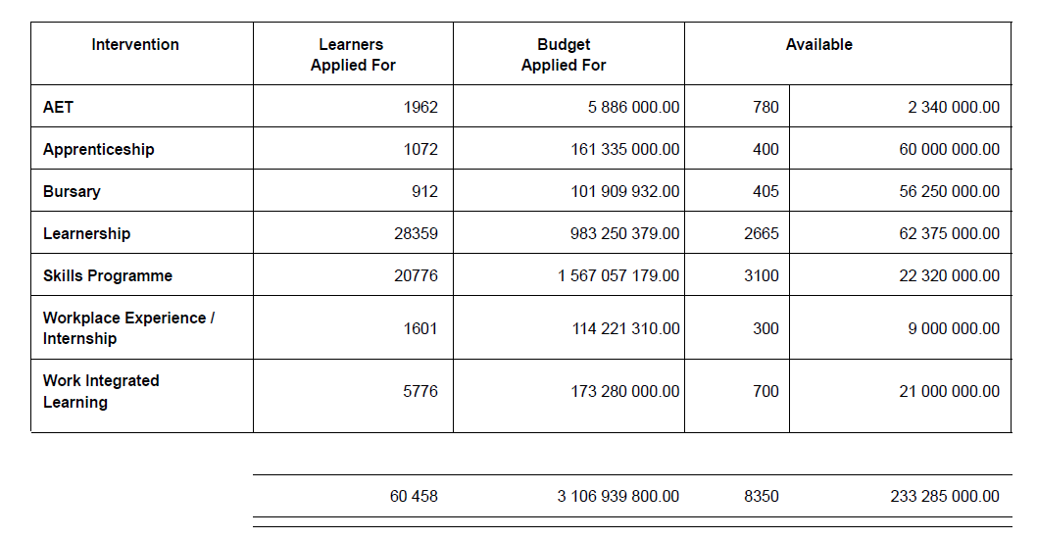
Section 2: Statistical Overview of 2016 Applications

Slide 9
Section 3 : Challenges
Some of the following Challenges were encountered:
Invalid documentation (Tax clearance, etc.)
Outside FP&M SETA Scope
Incomplete / pending submissions.
Failure to meet deadline.
Over subscription (Statistics provided)
WSP and Pivotal Plan submitted and not approved
Projects applied for not linked to approved Pivotal Plan

Slide 10
Challenges
Applications not addressing Scarce and Critical Skills of the sector
Request for changes to funding awarded that ends up affecting targets
Unrealistic applications. i.e. Applying for 500 learners when our budget is for 600 learners

Slide 11
Section 4: DG Purpose
Purpose of Discretionary Grants:
  To implement projects which assist the SETA in meeting the following:
      Sector Skills Plan.
      Strategic Plan.
      Annual Performance Plan.
  As agreed and signed between the Department of Higher Education and the SETA.

Slide 12
Section 5: APP Targets 2017/2018
PERFORMANCE INDICATORS | SETA FUNDED TARGETS
4.1 Number of learners entered into artisan programmes. | 350
4.2 Number of learners completed artisan programmes. | 225
4.3 Number of unemployed learners completed artisan programmes placed in employment. | 120
4.4 Number of unemployed learners entered into Learnership programmes. | 1,800
4.5 Number of unemployed learners completed Learnership programmes. | 1250
4.6 Number of unemployed learners completed Learnership programme placed in employment | 585
4.7 Number of unemployed learners entered into Bursary programmes | 300
4.8 Number of unemployed learners completed Bursary programmes. | 130

Slide 13
APP Targets 2017/2018
PERFORMANCE INDICATORS | SETA FUNDED TARGETS
4.9 Number of unemployed learners completed bursary programme placed in employment. | 40
4.10 Number of learners entered Post -Graduate Bursary programmes. | 7
4.11 Number of learners completed Post -Graduate Bursary programmes. | 3
4.12 Number of partnership agreements established with universities during the year to address scarce and critical skills | 3
4.13 Number of unemployed learners entered Workplace Experience/Internships. | 250
4.14 Number of unemployed learners completed Workplace Experience / Internships. | 175

Slide 14
APP Targets 2017/2018
PERFORMANCE INDICATORS | SETA FUNDED TARGETS
4.15 Number of unemployed learners entered skills programmes. | 850
4.16 Number of unemployed learners completed skills programmes. | 600
5.1 Number of learners who entered AET programmes. | 630
5.2 Number of learners who completed AET programmes. | 440
5.3 Number of collaborative partnership agreements signed with youth development organisation. | 3
5.4 Number of bridging programmes with learners implemented | 2

Slide 15
APP Targets 2017/2018
PERFORMANCE INDICATORS | SETA FUNDED TARGETS
6.1 Number of employed learners entered skills programmes. | 2,050
6.2 Number of employed learners completed skills programmes. | 1,500
6.3 Number of employed learners entered into Learnership programmes. | 800
6.4 Number of employed learners completed Learnership programmes. | 560
6.5 Number of employed learners entered Bursary Programmes. | 100

Slide 16
APP Targets 2017/2018
PERFORMANCE INDICATORS | SETA FUNDED TARGETS
6.6 Number of employed learners completed Bursary Programmes. | 40
6.7 Number of unemployed learners entered Work-Integrated Learning Programmes from TVETs. | 400
6.8 Number of unemployed learners completed Work-Integrated Learning Programmes from TVETs. | 275
6.9 Number of unemployed learners entered Work-Integrated Learning Programmes from HETs. | 200
6.10 Number of unemployed learners completed Work-Integrated Learning Programmes from HETs. | 150

Slide 17
APP Targets 2017/2018
PERFORMANCE INDICATORS | SETA FUNDED TARGETS
7.1 Number of Co-operatives Supported | 20
7.1 Number of Small Business Supported | 20
7.1 Number of NGOs Supported | 3
7.1 Number of CBO Supported | 3
7.1 Number of NLPE Supported | 5
7.1 Number of Trade Unions Supported | 2
7.2 Number of rural development projects supported. | 20

Slide 18
Section 6: Scarce & Critical Skills
Skills gaps within FP&M organisations
Deficiencies of specific knowledge, experience or competencies
    Influence level of effectiveness
    Hinder business growth

Slide 19
Scarce & Critical Skills
The Scarce and Critical Skills List :
  Address skills development imperatives
  Ensure alignment to the Human Resource Development Strategy
  Inform SETA funding and training facilitation according to industry needs

Slide 20
Scarce & Critical Skills
Addressed through interventions and short courses
  Strategic management, leadership skills, industrial relations, financial management, train-the-trainer, supervisory development etc.

Slide 21
Scarce & Critical Skills
OCCUPATIONAL CATEGORY | OCCUPATION (SPECIALISATION)
Managers | Human resources, training and education, logistics, production and quality management; supervisors, small business owner/manager
Professionals | Work study officers, designers (including fashion and graphic designers), industrial and chemical engineers, forest scientists and sales and marketing specialists, ETD practitioners, editors
Technicians and trades workers | Technologists and technicians (specializing in different disciplines), fitters and turners, printing machinists, patternmakers and mechanics, computer network technicians, electricians, production / operations supervisor (manufacturing)
SCARCE
Insufficient number of qualified and experienced people in specific occupations

Slide 22

Scarce & Critical Skills
OCCUPATIONAL CATEGORY | OCCUPATION (SPECIALISATION)
Community and personal service workers | Fire fighters (forestry)
Clerical and administrative workers | Cost clerks, production coordinators and environmental practices inspectors;
Machinery operators and drivers | Machine operators and mobile plant operators, machinists, upholsterers, cabinet makers, footwear closing production machine operator, leather processing machine operator, textile / leather / material cutting machine operator, sewing machine operator
Elementary workers | Sawmill or timber yard workers, harvesters and printing table workers, pest or weed controllers, textile, clothing and footwear factory worker

Slide 23
Scarce & Critical Skills
  The list is available from the FP&M SETA website: www.fpmseta.org.za
  NB: Scarce and Critical Skills take priority over all other intervention applications.

Slide 24
Section 7 :DG Interventions Costing
Intervention | Duration | Cost ( VAT Zero Rated)
 |  | Employed 18.1 | Unemployed 18.2
Learnerships | 12 Months | R 20,000.00 | R 25,000.00
Apprenticeships Section 13 | 3 - 4 Years | R 50.000.00 per year for three years | R 50.000.00 per year for three years
Apprenticeships Section 28 | None | Per Trade Test
 |  | R 5,000.00

Slide 25
DG Interventions Costing
Intervention | Duration | Cost ( VAT Zero Rated)
Bursaries | 2 - 4 Years | Employed & Unemployed
 |  | R 35,000.00
 |  | Undergraduates | Postgraduates
 |  | R 35.000.00 per year for three study years | R 50.000.00 per year for two study years
Skills Programmes | 3 - 9 Months | Technical
 |  | R 7200.00 (minimum 45 credits)
 |  | Occupational - Unemployed 18.2
 |  | R 7200.00 (minimum 45 credits)
 |  | Occupational - Employed 18.1 (RPL)
 |  | R 5,000.00

Slide 26
DG Interventions Costing
Intervention | Duration | Cost ( VAT Zero Rated)
Work Experience | 6 - 12 Months | 6 Months | 12 Months
 |  | R 15,000.00 | R 30,000.00
Internships | 6 - 12 Months | Learner Allowance for 6 Months
 |  | Maximum R 15 000.00
 |  | Learner Allowance for 12 Months
 |  | Maximum R 30 000.00
WIL | 18 Months | Learner Allowance for 18 Months
 |  | Maximum R 45 000.00
AET | 12 Months Per Level | R 3,000.00

Slide 27
Section 6: Apprenticeship Wage
Printing, Packaging and Textile Sector Specific Wage Rates as of 2016/2017:
Minimum Wage Scales for Apprentices - Printing & Packaging
 | 2016 | 2017 | 6.5% Increase | Daily | Weekly | Monthly
PHASE 1 & 2: | R 1,117.22 | R 72.62 | R 1,189.84 | R 237.97 | R 1,189.84 | R 5,152.00
PHASE 3: | R 1,246.28 | R 81.01 | R 1,327.29 | R 265.46 | R 1,327.29 | R 5,747.16
PHASE 4: | R 1,710.11 | R 111.16 | R 1,821.27 | R 364.25 | R 1,821.27 | R 7,886.09

Slide 28
Apprenticeship Wage
Minimum Wage Scales for Apprentices -Textile Sector
 | 2016 hourly | 2017 8% | Hourly | Daily | Weekly | Monthly
First Year | R 25.93 | R 2.07 | R 28.00 | R 252.04 | R 1,260.20 | R 5,460.86
Second Year | R 28.50 | R 2.28 | R 30.78 | R 277.02 | R 1,385.10 | R 6,002.10
Third Year | R 34.00 | R 2.72 | R 36.72 | R 330.48 | R 1,652.40 | R 7,160.40

Slide 29
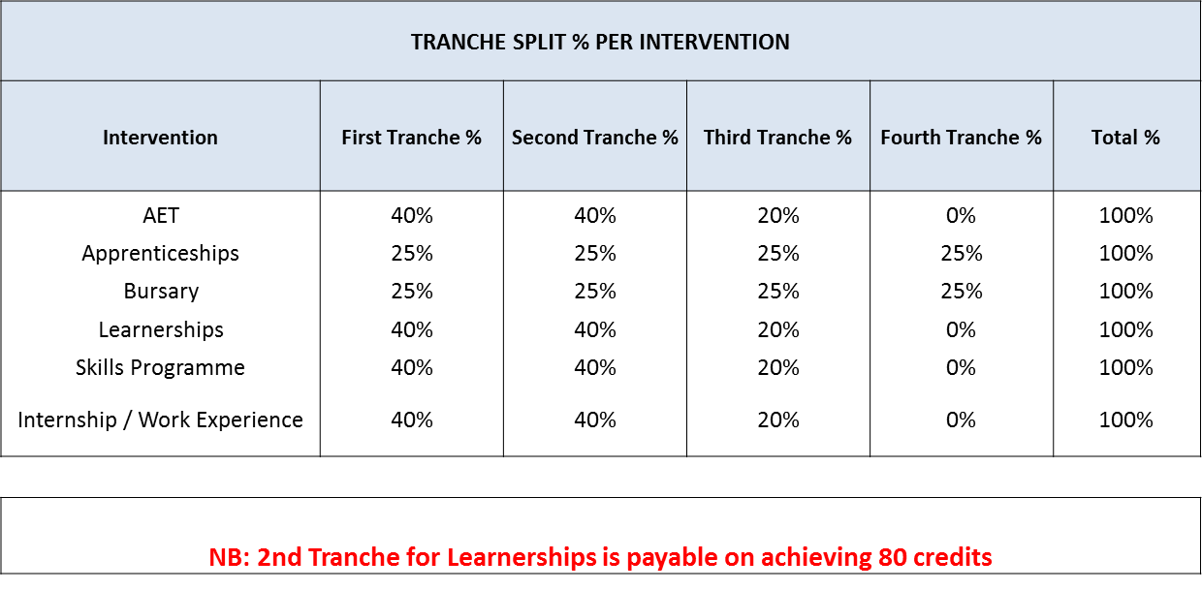
DG Purpose: Tranche Splits per Intervention

Slide 30
Section 8: Contact Details
REGIONAL OFFICES
HEAD OFFICE
Projects
  Chereece Samuels-Balkisson
  011 403 1700
  ChereeceB@fpmseta.org.za
Johannesburg
  William Malema – 011-403 1700
  WilliamM@fpmseta.org.za
Cape Town
  Leigh Hayes– 021-462 0057
  LeighH@fpmseta.org.za
Durban
  Lungile Shabangu– 031-7024482
  LungileS@fpmseta.org.za

Slide 31


Section 9: Questions and Answers

Slide 32

Thank You

