Slide 1


A COLLABORATIVE APPROACH TO ENHANCING A DIGITAL CULTURE 4th June 2020
DIGITAL CONVERSATIONS WITH THE CEO

Slide 2
CONTENT
Skills Planning and Reporting Mandatory Grants
Research A Digital Online Approach
Communications & Marketing
Monitoring and Evaluation
FP&M SETA Online Platform
Concluding Remarks
CEO Introduction & Opening Remarks
Employer Workplace Readiness Survey
Quality Assurance Online Systems
Projects Online Module

Slide 3

CEO Introduction & Opening Remarks

Slide 4
INTRODUCTION
As the Coronavirus pandemic continues to grip economies across the globe, few organisations have been left untouched by its effects
The social and economic impact of Covid-19 has forced most organizations to operate according to a “new normal”
Keeping up with the global trends of being agile, FP&M SETA is exploring interactive digital platforms
FP&M SETA is currently embracing a business-wide online work ethic
The digital culture is a blanket concept that uses technology to shape the way we interact, behave, think and communicate as human beings

Slide 5
Employer Workplace Readiness Survey

Slide 6
EMPLOYER WORKPLACE READINESS SURVEY
1. Have you as employer or skills development provider opened up your premises for training?
Yes or No. If NO provide a reason/s
2. Is your workplace aligned to Covid-19 Health and Safety Regulations?
Yes or No. If NO provide a reason/s
3. Are learners back in the classroom?
Yes or NO. If NO provide a reason/s - By when are learners expected to return
4. Have learners being paid a learner stipend since lockdown?
Yes or No. If NO provide a reason/s

Slide 7
Quality Assurance Online Systems

Slide 8
QUALITY ASSURANCE ONLINE SYSTEMS
The QA division has the following systems:
ORAM (Online Registration of Assessors & Moderators)
Online Registration of Learning Programmes
Verification of Learner Achievements

Slide 9
ORAM
ORAM is an online application for Assessor and Moderator Registration
Desk-top evaluation for accreditation of skills development providers is done online

Slide 10
ONLINE REGISTRATION OF LEARNING PROGRAMMES
QA systems allows for learners to be registered online
Assessments and moderation of portfolios of evidence can also be done online
Online functionality makes provision for filing & reporting of learner achievements

Slide 11
VERIFICATION & CERTIFICATION
Sector Skills Advisors (SSAs) use online platforms for QA audits & verification of learner achievements
Achieved learners are issued with certificates and/or statement of results

Slide 12
DHET REGISTRATION - PRIVATE TRAINING PROVIDERS
QCTO will register private Skills Development Training Providers online once accredited for occupational qualifications
Private Skills Development Training Providers interested to register with the DHET can liaise with the FP&M SETA QA for assistance

Slide 13
OCCUPATIONAL QUALIFICATIONS DEVELOPMENT
59 Occupational Qualifications are registered with SAQA
97 Occupational Qualifications recommended for registration with
SAQA
04 Are still in the evaluation process at the QCTO
The FP&M SETA is working with the QCTO to fast-track registration of all outstanding occupational qualifications

Slide 14
QCTO’s ONLINE E-LEARNING AND E-ASSESSMENT
These guidelines are applicable during the COVID-19 Pandemic
The guidelines will be reviewed post lockdown
Guideline can be accessed on the link

Slide 15
QCTO ACCREDITATION OF TRAINING PROVIDERS
QCTO is currently developing an online module to allow online application for accreditations
The module will be made available for public use
The module will only be applicable for Occupational Qualification accreditations

Slide 16
Projects Online Module

Slide 17
PROJECTS ONLINE MODULE
The current system allows for:
Application for DG project online during the Open Window
Contract generation
Downloading of Formal Commitment for signature
Notification of DG application status and outcome

Slide 18
PROJECTS MODULE ENHANCEMENTS
Linking of learners from the Learners Registration Module (QA) to the DG Approval and Reference numbers
Online payment process that allows for Tranche payment management, contract management, learner dropout management
Monitoring and Evaluation against DG References and Companies
Online notifications to both SETA and Seta Providers when specific action is required

Slide 19
PROJECTS MODULE ENHANCEMENTS
Document Management (i.e. forms, attendance registration, invoices, progress report, close out reports)
Integration with Finance and Reporting for when learners are entered and completed
Online stakeholder management (queries etc.)
Reporting via Commitment Register

Slide 20
Skills Planning and Reporting Mandatory Grants

Slide 21
SKILLS PLANNING & REPORTING – MANDATORY GRANT
Annual online submission by companies by 30th April:
Workplace Skills Plan
Annual Training Report
Pivotal Plan
Submission of the WSP/ATR is done through an online system, which allows for companies to directly upload the WSP/ATR forms onto an electronic data capture system
Assist SETA to evaluate alignment of planned versus actual training & final approval of WSP/ATR and Pivotal Plan

Slide 22
Research A Digital Online Approach

Slide 23
RESEARCH – A DIGITAL ONLINE APPROACH
Research aims to develop a quality Sector Skills Plan and accurate PIVOTAL List:
Digital discussions, surveys, interviews, focus groups for SSP update to be conducted using online systems
Researchers able to access a wide range of search engines with regard to data and quantitative statistics

Slide 24
Communications & Marketing

Slide 25
COMMUNICATIONS & MARKETING
Regular Career Webinars
Digital online advertisements & communication (online workshops & seminars)
Informative online e-mail banners
Online Career Brochure
Regular online website analytics
Online SETA Newsletters
Active online social media platforms

Slide 26
Monitoring and Evaluation

Slide 27
MONITORING & EVALUATION
Monitoring is an ongoing and systematic activity used to track whether activities are carried out according to the MOU
Currently Sector Skills advisors are appointed to perform site visits, collect data and submit online to the monitoring and evaluation team
Evaluation verifies whether project objectives have been achieved or not

Slide 28
M&E AREAS TO BE ENHANCED
Online module is being revised and updated – to be integrated with Projects & QA Divisions
The current method of collating data by SSA’s and the submission will be a fully online process
Surveys must be developed to be conducted utilizing digital platforms
Evaluation reports should be electronically available and accessible at all times

Slide 29

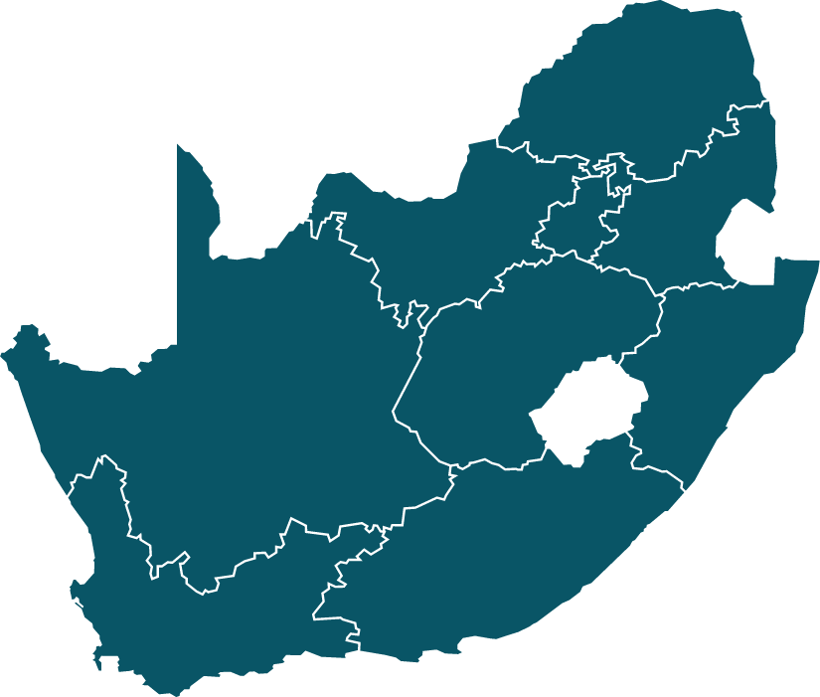
MONITORING & EVALUATION
Summary update of the Online M&E conducted
From end March 2020 a total of 65 companies have been identified as having been paid the 1st Tranche but no site visit has been conducted and the breakdown:
Total Companies | Gauteng | Kwa Zulu Natal | Western Cape | Tot
 | 33 | 35 | 29 | 97
Visited | 18 | 22 | 12 | 52
Not Visited | 15 | 13 | 17 | 45

Slide 30
FP&M SETA Online Platform

Slide 31
FP&M SETA ONLINE PLATFORM
COMMUNICATION
VOIP Telephone System
Codec Video Con System
Zoom
Microsoft Teams
Websites
Skype
E-Mail
Facebook-#FP&MSETA
Link In Google Hang out
SUPPORT
TeamViewer
Any desk
Microsoft Remote Desk
Career Portal ( Enhancement )
E-Learning ( Development)
Learner Management Information System (LMIS)

Slide 32
USEFUL LINKS TO SYSTEMS AND WEBSITES
QCTO
http://www.qcto.org.za
SAQA
https://www.saqa.org.za/
ORAM
https://indicium.fpmseta.org.za/Account/Login.aspx
FP&M SETA stakeholder login
https://indicium.fpmseta.org.za/Account/Login.aspx
FP&M SETA Career portal
https://www.careers-fpmseta.org.za/
FP&M SETA Website
https://www.fpmseta.org.za/default.aspx

Slide 33
Concluding Remarks

Slide 34
CONCLUSION
STAKEHOLDER READINESS
Are stakeholders ready to convert to a digital process?
What support can we provide to our stakeholders to assist them in this journey?

Slide 35

EXTENSION OF REQUEST FOR INFORMATION

Slide 36

Thank You

