Slide 1

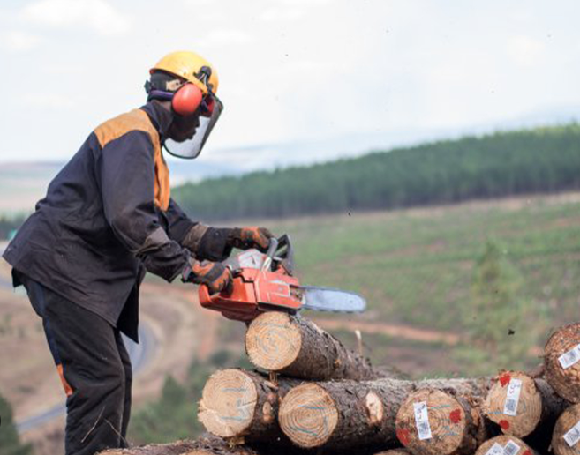
MD & DG STAKEHOLDER WORKSHOP 2024/25
IT SYSTEMS PRESENTATION
By
Mr. Bongani Masango (CIO)
Date: February 2024

Slide 2



CONTENTS
LMIS ENHANCEMENTS
LMIS SUPPORT AND DEMONSTRATION
CAREER PORTAL BACKGROUND
CAREER PORTAL DEMONSTRATION
e-QUALIFICATION PORTAL DEMONSTRATION

Slide 3


LMIS ENHANCEMENTS SUMMARY, SUPPORT AND DEMONSTRATION

Slide 4
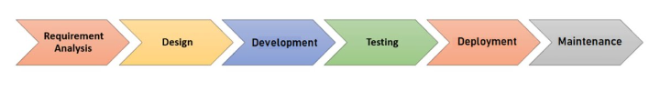

LMIS ENHANCEMENT FOR SYSTEM EFFECTIVENESS
Enhancements Definitions
Methodology: Agile and Dev-Ops
How enhancements are solicited
PROJECT MODULE ENHANCEMENT
                Auto-populate key information from current submissions, during a DG Application. E.g., Company details, contact information, and address.
                Single update for one profile on multiple modules
                Capture OFO aligned to qualification
4

Slide 5
LMIS ENHANCEMENT FOR SYSTEM EFFECTIVENESS
SP&R MODULE ENHANCEMENT
Prepare submission data early and avoid last-minute information capturing
Training Intervention
Employee data
Training Planned / Implemented
Retrieve previous years’ submission data, therefore allowing stakeholders to update information and capture less data.
More training and support on Excel capturing
Single update for one profile on multiple modules
5

Slide 6
LMIS ENHANCEMENT FOR SYSTEM EFFECTIVENESS
QA MODULE ENHANCEMENT
Send Notifications for Registrations expiring 6 months before.
Learner’s supporting documents verification
Auto enroll learners which are verified when creating a class.
Allow multiple SDF Registration for both SETA Funded and Industry Funded
Registration of Assessor and Moderator currently online
Application for accreditation for SDP’s online
Capture OFO aligned to qualification
6

Slide 7
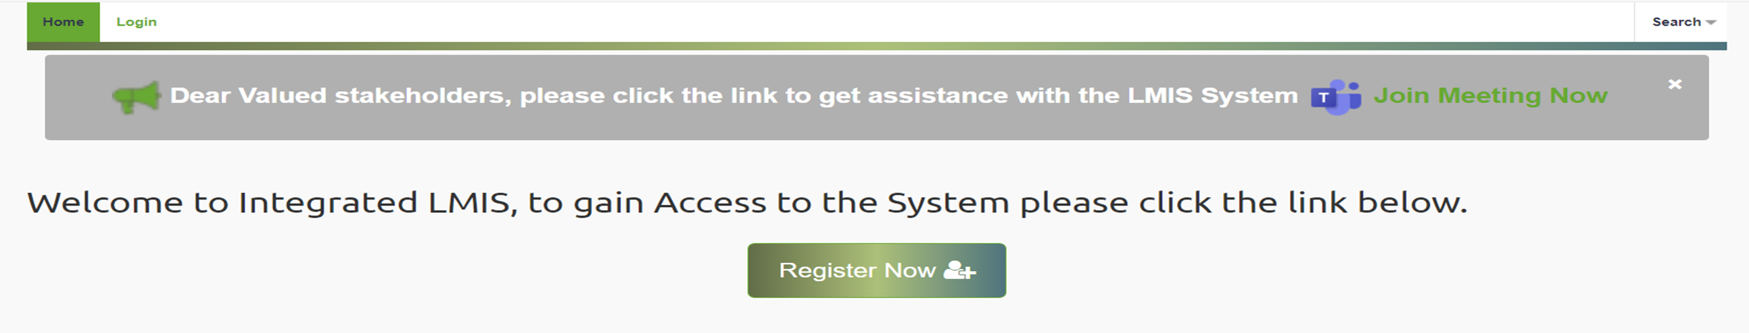

LIVE DEMONSTRATION: https://fpmseta.endorseds.co.za/
Online Support Team through team
Weekly training and support for Stakeholders
Ticket Reference Numbers
Support Service Rating
LMIS
SUPPORT

Slide 8
e-Qualification AND CAREER Portal

Slide 9
Background, Status, and Progress
  Database of the qualified candidates \ learners
  Bridging the gap between qualified candidates and employers
  10320 Qualified Registered candidates \ learners
  Career Portal Revamped
  Advertised Opportunities - (Extremely low and we need more for better impact)
  Continuous updating of learners and available opportunities
  Create more awareness of the portal during DG and MG workshops
  https://www.careers-fpmseta.org.za
CAREER PORTAL UPDATE

Slide 10
Background, Status and Progress
  FP&M SETA has deployed a value-add e-qualifications solution that will assist stakeholders in conducting blended learning, online assessment, moderation, and content upload
  SDP can manage learners and documentation on the solution
  Registered occupational qualifications are being digitized and uploaded on the platform
  Eleven (11) approved Occupational Qualifications completed and currently in continuous improvement mode
  System is accessible to unlimited
  PR company and Coms team have completed reviewing content
  https://fpmlearning.org.za/
e-QUALIFICATION UPDATE

Slide 11
Three Months Plan
  Ensure effective and efficient system functionality during the MG-DG application
  Increase stakeholder support
  Increase system capacity for faster processing
  Increase career and e-qualification usage through awareness campaigns ( social media, website, forums, workshops, )
  Weekly capacity-building session
  Software License Renewals
  Upgrade or improve infrastructure and connectivity
Three Months Plan
January – March
2024

Slide 12
THANK YOU
Q&A

